Slide 1


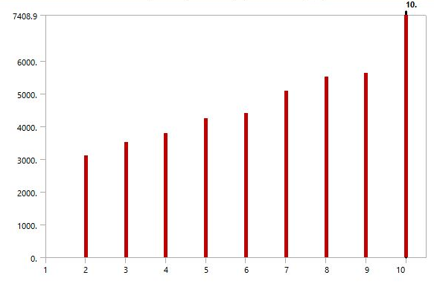
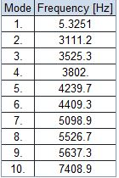
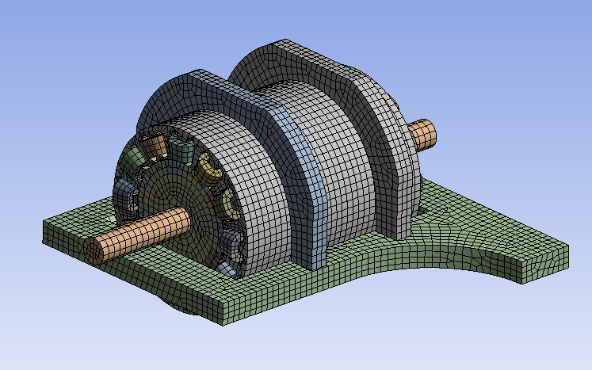
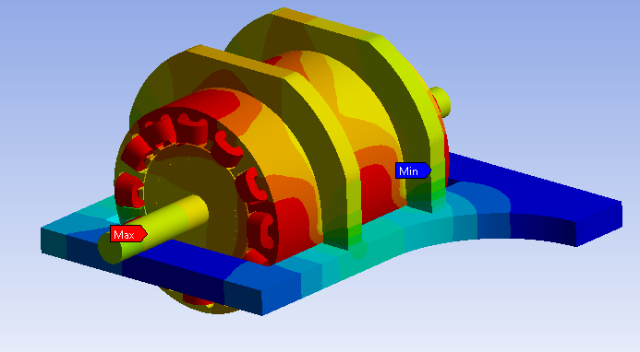
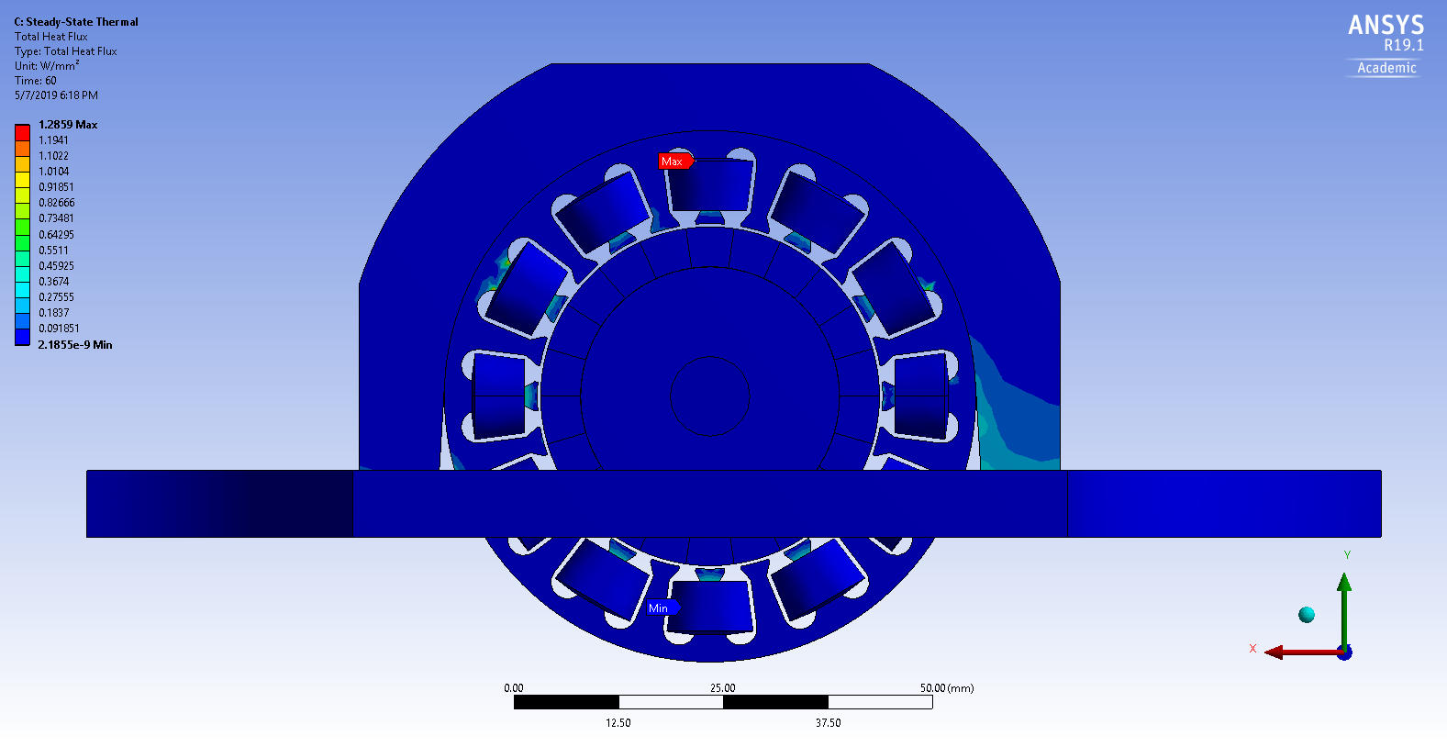
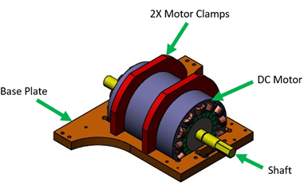
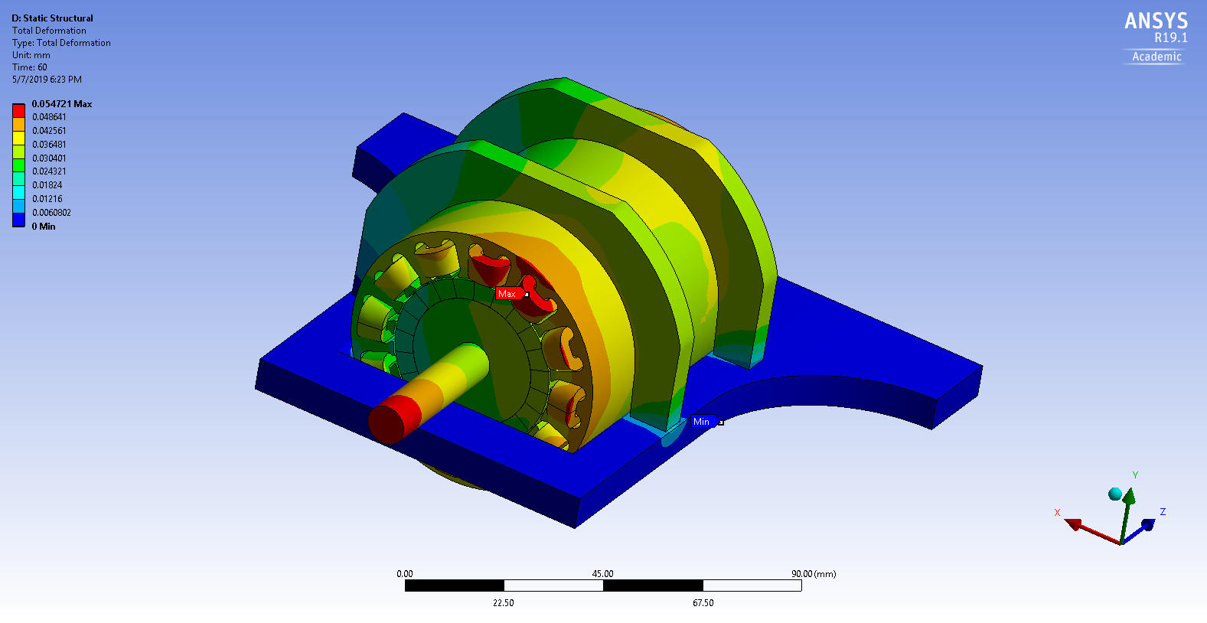
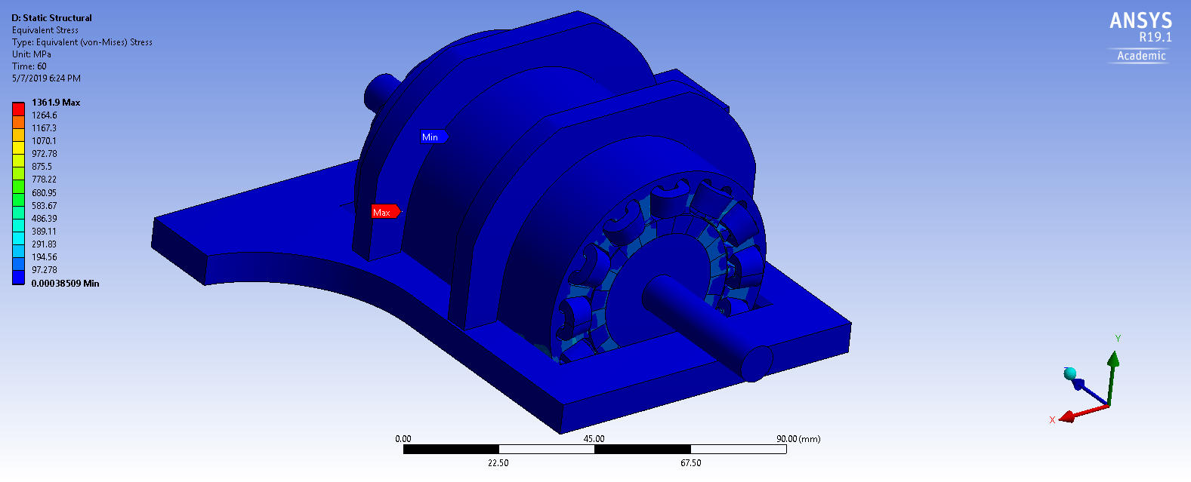
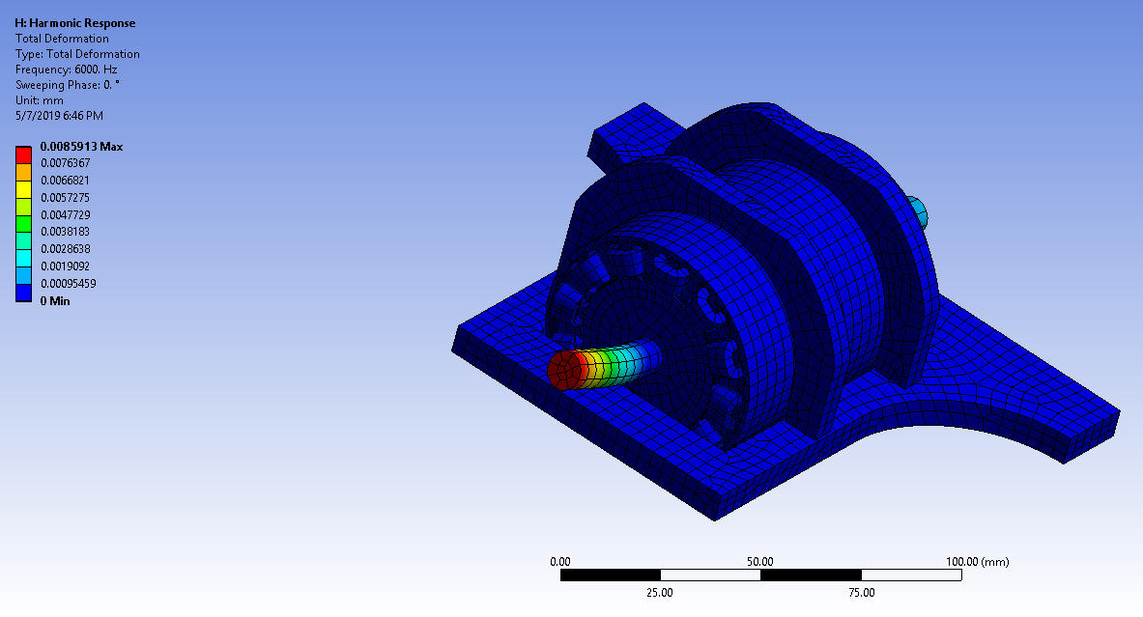
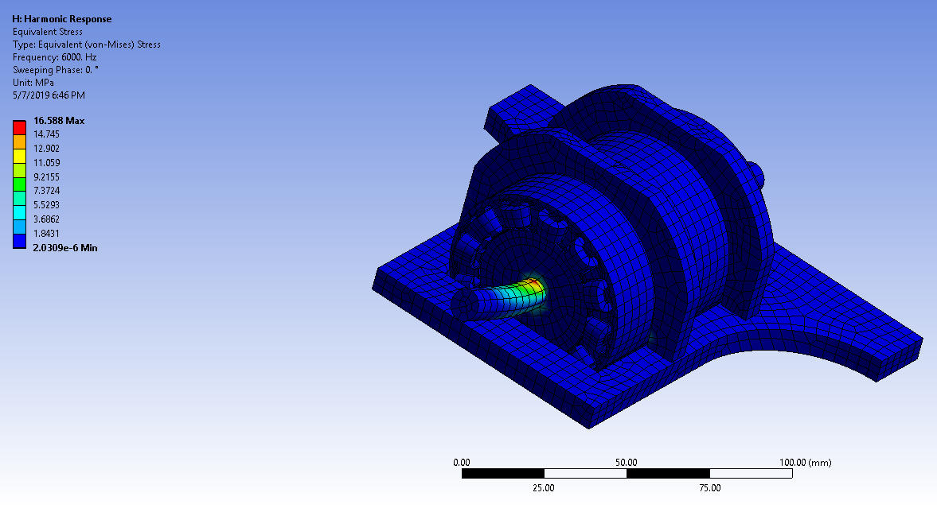
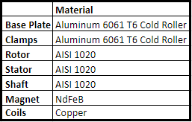
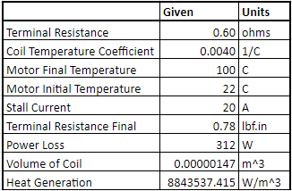
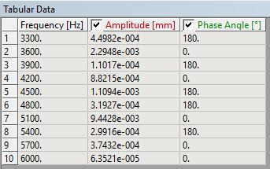
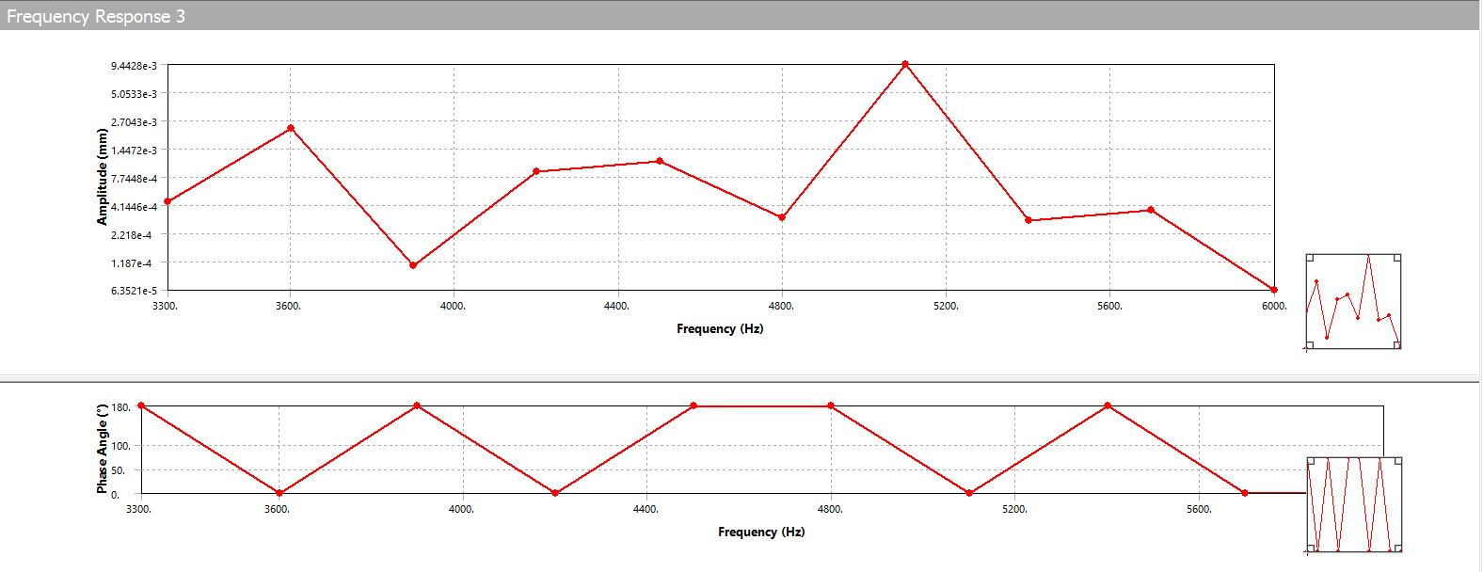
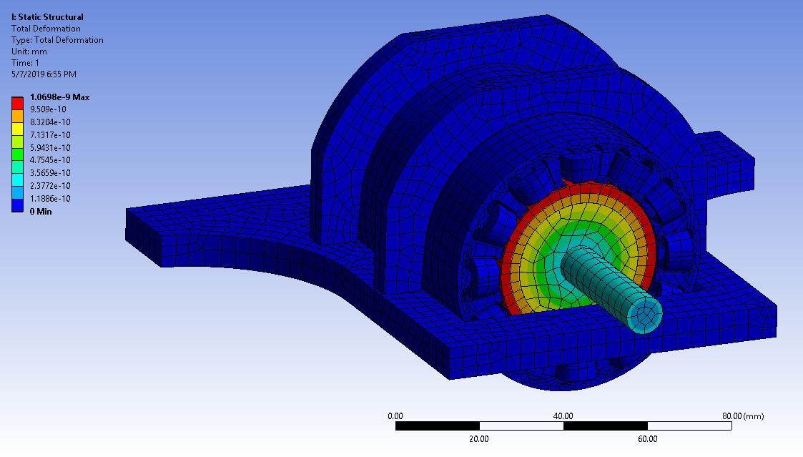
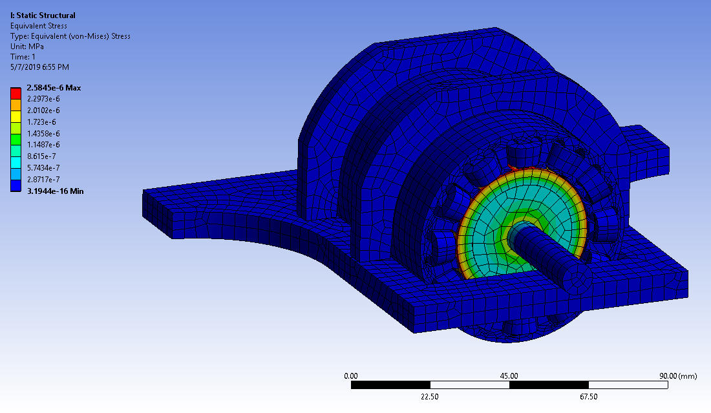
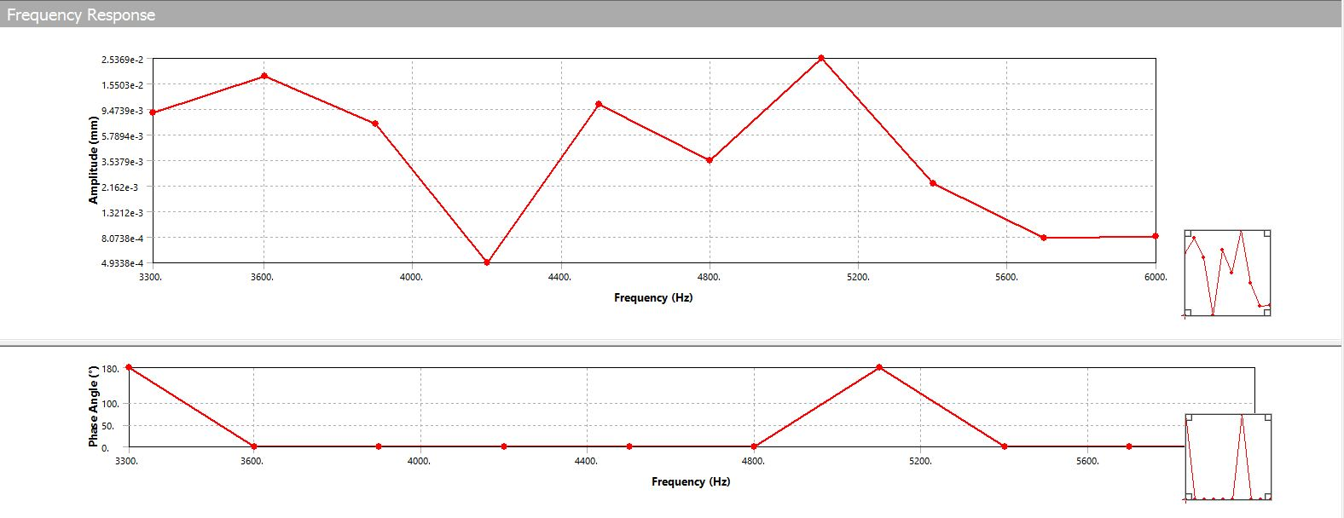
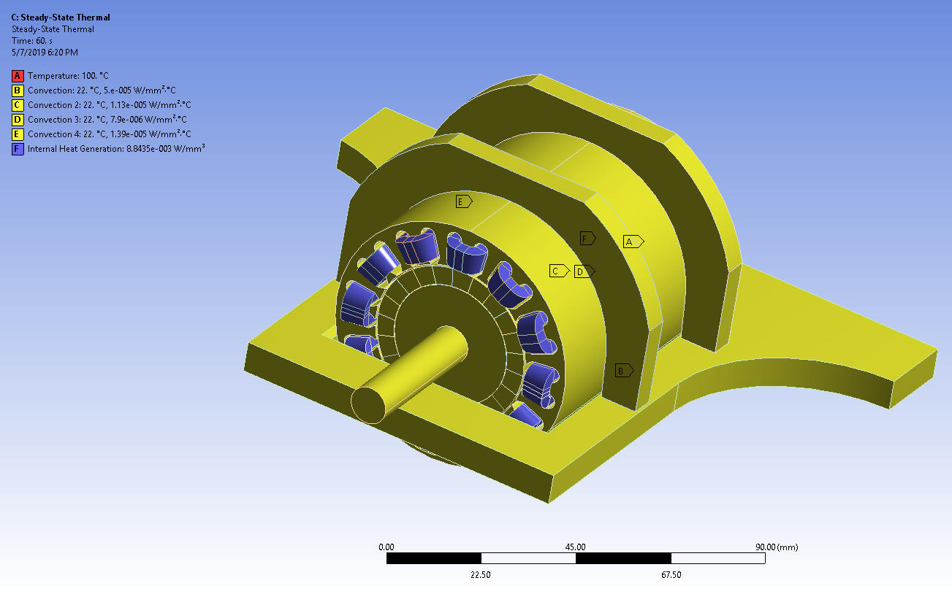
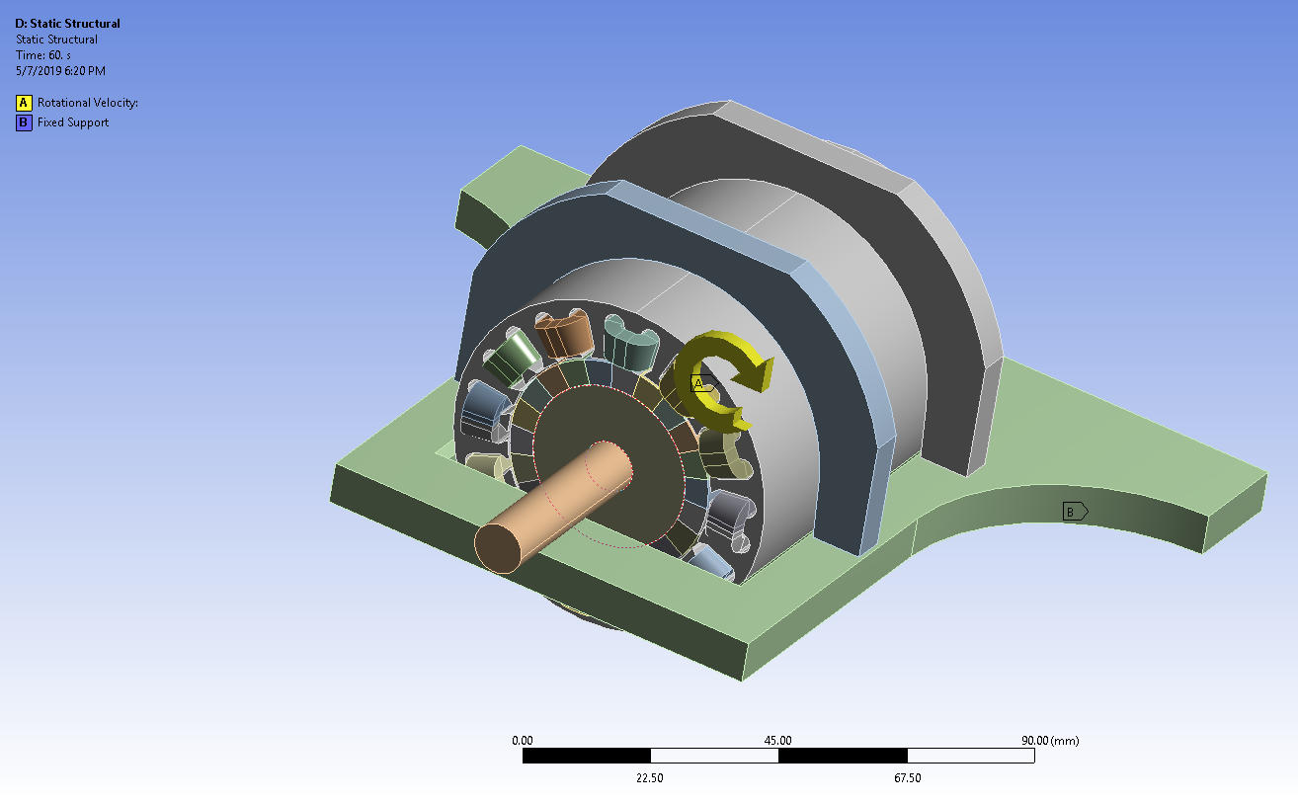
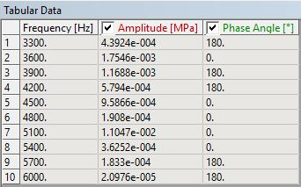
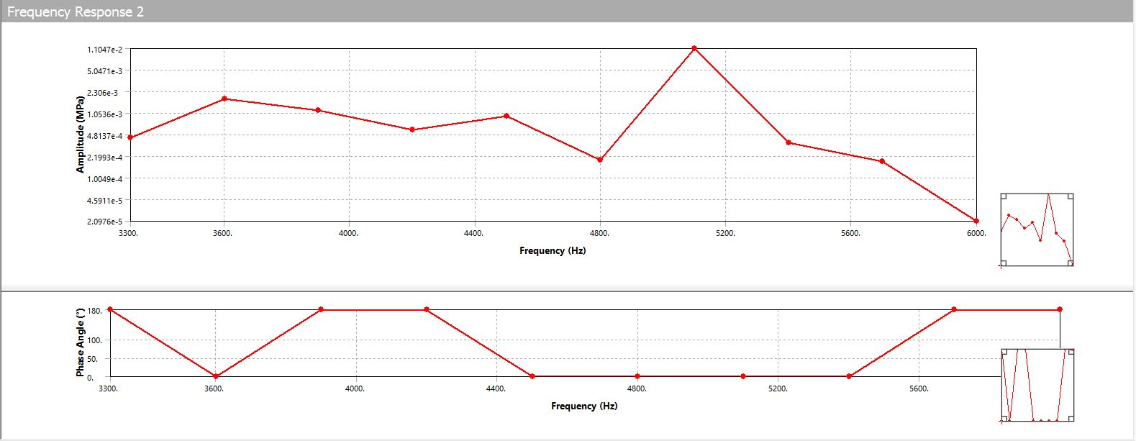
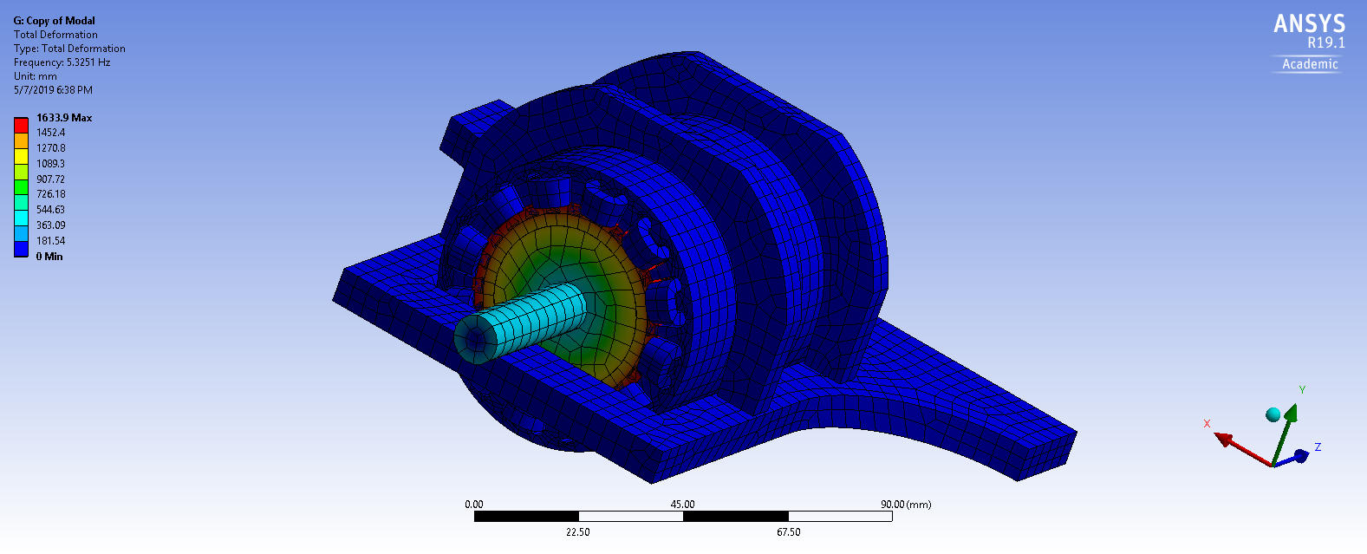
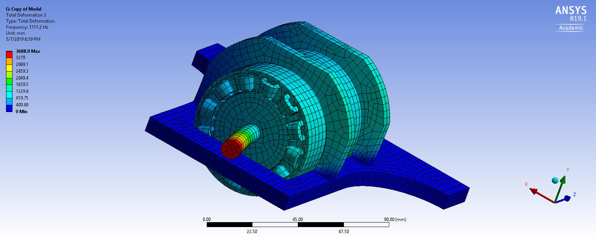
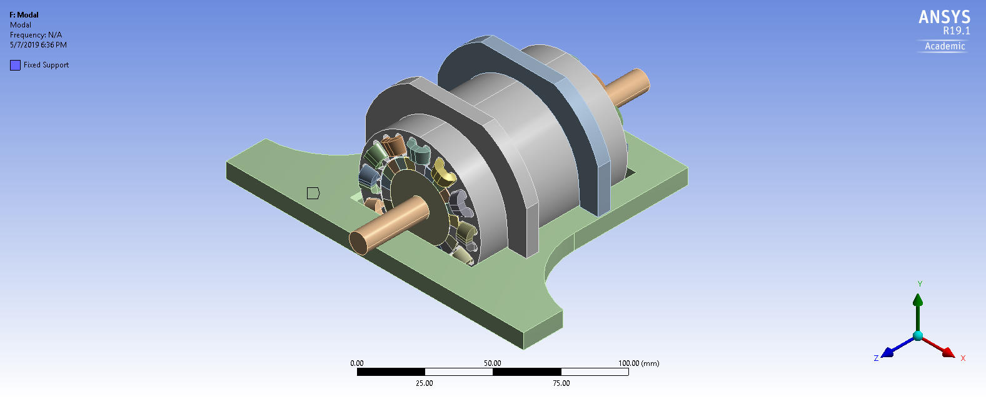
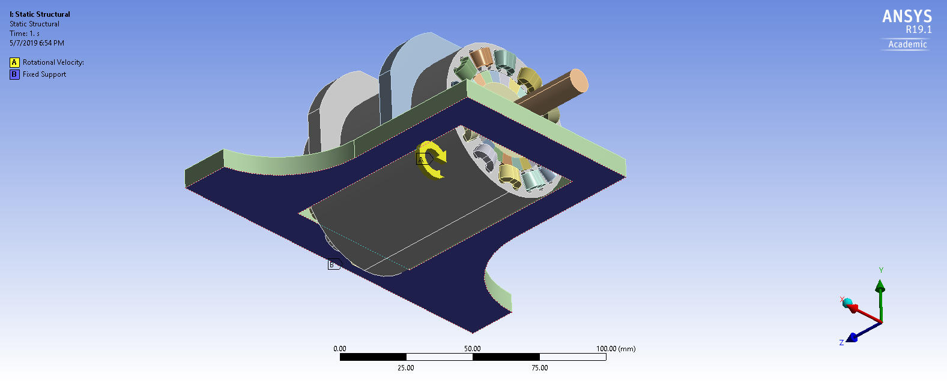
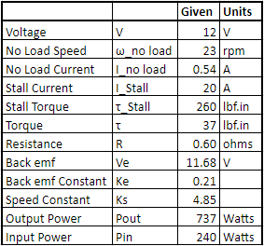
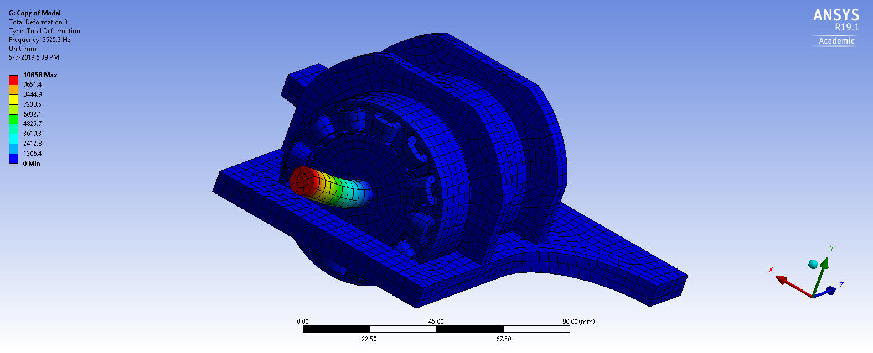
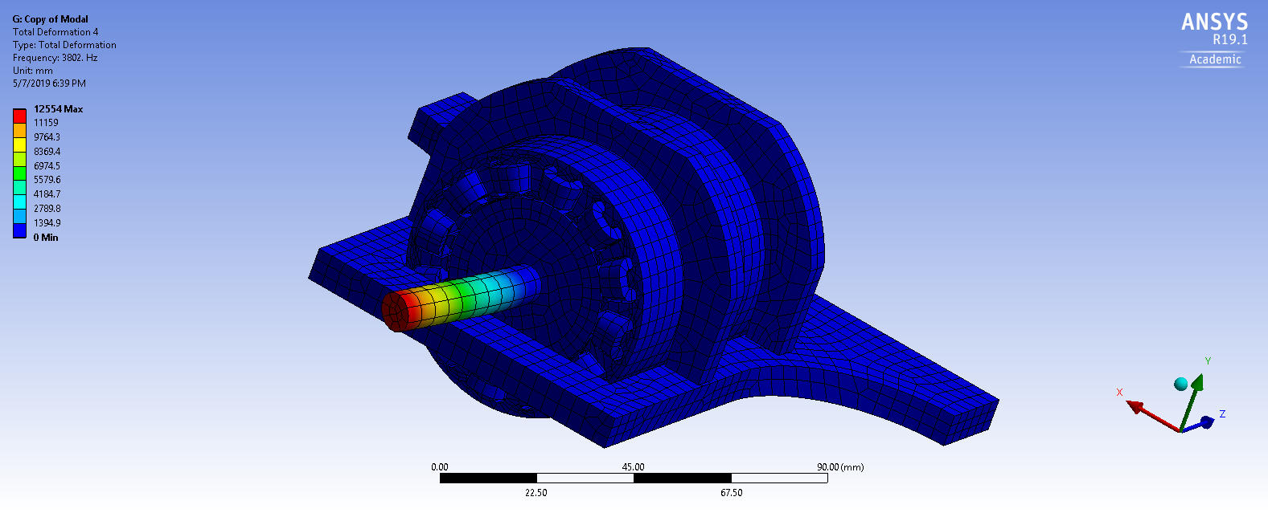
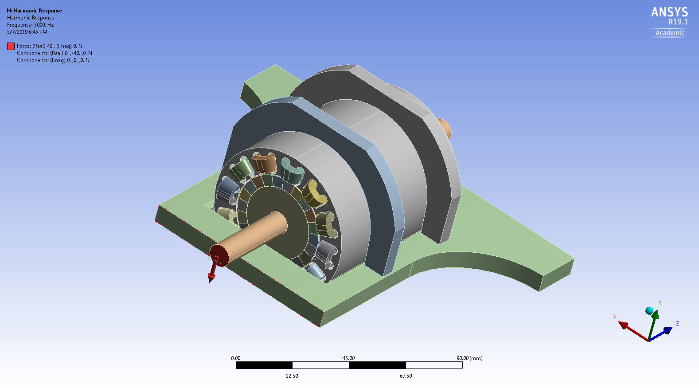
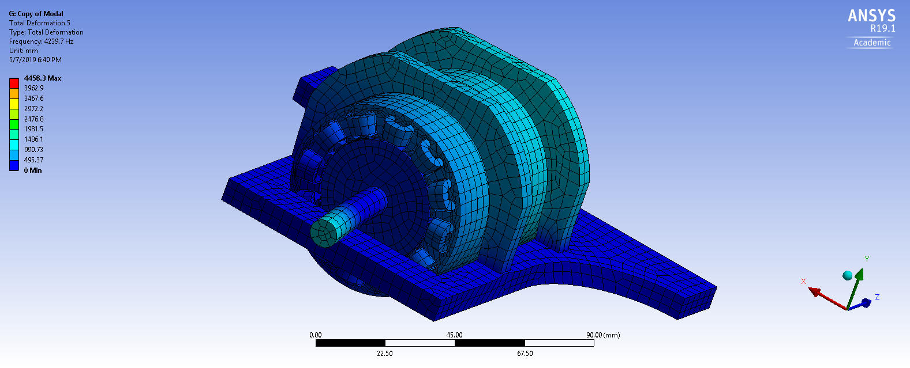
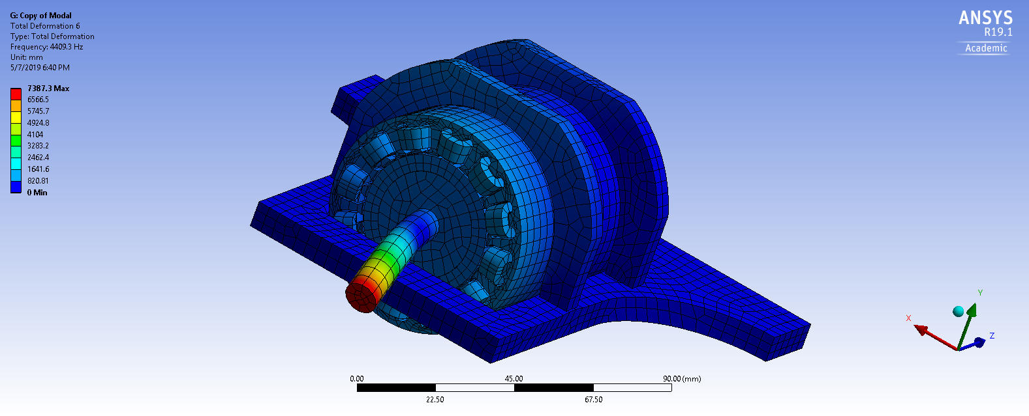
THERMAL AND HARMONIC ANALYSIS OF A DC MOTOR
ME 274 – ADVANCE FINITE ELEMENTS METHODS IN
ENGINEERING
SAN JOSE STATE UNIVERSITY
NEEL SHAH | TEJAS VANDRA | DHARMESH PATEL
1. INTRODUCTION
4. GEOMETRY AND MESH
7. RESULTS
7.1. STEADY STATE THERMAL
Thermal analysis gives us the heat distribution and flux direction.
Thermal analysis was followed by Non-Linear Structural Analysis which gave us result of the deformation and stresses generated by the thermal loads acting on DC Motor.
Fig 8 - Temperature Distribution Fig 9 - Steady State Total heat flux
Fig 10 - Total Deformation Fig 11 - Von Mises Stress
7.2 Modal Analysis
For modal analysis, we observed that the natural frequencies were clustered in range of 3000 to 7000 Hz.We neglected some random frequencies like 5.35 Hz,7408 Hz etc. since they were too random. Hence, we focused our analysis between 3000-7000 Hz as they gave us more accurate data.
The following figures display the modal shapes and total deformation of the body.
Fig 12 - Static Structural Total Deformation Fig 13 - Static Structural Von Mises Stress
Fig 14 -Modal Deformation 1 Fig 15 - Modal Deformation 2
Fig 16 - Modal Deformation 3 Fig 17 - Modal Deformation 4
Fig 18 - Modal Deformation 5 Fig 19 - Modal Deformation 6
7.3 HARMONIC RESPONSE
Here, we assumed a scenario when the motor is loaded and it has some harmonic force that acts continuously on the end face of shaft in downward direction
We see that there is stress concentration at the junction of shaft and housing due to sharp edges.
The deformation and stresses are concentrated on the shaft instead of the whole body. This is because the motor body is fixed at the bottom and shaft is not in direct contact with the housing of motor.
The frequency response graphs show us a more lucid picture.
Fig 21-Harmonic Response Total Deformation Fig 22- Harmonic Response Equivalent Stress
Fig 23-Harmonic Response X direction Deformation
Fig 24 - Harmonic Response Y directional Deformation
Fig 25 - Harmonic response Y direction Normal Stress
12. CONCLUSION
Deformation and stress due to thermal convection are shown in Steady State Thermal analysis results section. Both the stress and deformation were under the design constraints.
Deformation for first 10 modes were shown in a chart in Modal Analysis results section. The deformation were all below design constraints.
Deformation and stress of rotor due to harmonic loading are shown in Harmonic Response results section. Both values are below design constraints.
The static analysis simulation and optimization was done using ANSYS 19.1
13. FUTURE WORK
Since the deformation and stress due to thermal load is less than expected, we plan on reducing the thickness of base plate and clamps.
Modes found from modal analysis will be used in future controls modeling and calculations. We can make sure to stop the robot when reaching natural frequency while in operation.
Frequency response graph will also be used in controls modeling to understand deformation due to harmonic loading when in operation.
We also plan on running impulse loading. In the case of the arm being hit by some external impulse load.
A DC motor is a class of rotary electrical machine that converts direct current electrical energy into mechanical energy. The most common types rely on the forces produced by magnetic fields.
The goal of this project is to understand steady state properties of the surroundings when coils in the stator generates heat due to the current needed closer to stall torque.
Secondary goal of this project is to find the natural frequency of the rotor at no load condition and its respective deformation.
Lastly, find the frequency response of the rotor at design load conditions.
The assembly file is designed using SolidWorks and imported in ANSYS as step file. Boundary condition can be seen in above pictures.
Method used for mesh was Hex-Dominant mesh with Quad/tri element order.
The element mesh size is
0.25 cm.
Total number of Nodes
= 233062
Total number of Elements
= 55122
Fig 20- Natural frequencies
5. DESIGN CONSTRAINTS
Fig 2 - Meshed Model
The maximum Stress should be less than the Allowable stress of the material.
The deformation in the model should be less than 1.25mm.
Consider a factor of safety of 1.2
6. BOUNDARY CONDITIONS
Fig 1 - DC Motor
Different boundary conditions are applied in different analyses.
Fixed support at the bottom face is
common in all the analysis.
Steady State Thermal Analysis:
Ambient temperature: 22 °C
Initial Temperature of coils: 100 °C
Heat Generated by coils: 8843537 W/mm³
Different convective conditions are applied
To respective bodies shown in materials
section.
Fig 3- Temperature and Convective B.C Fig 4-Rotational Velocity B.C
Modal Analysis
Rotational velocity on the rotor, coils and Magnet is 19 rpm based on the requirements.
Fig 5 - Fixed Support B.C Fig 6 - Rotational Velocity B.C
Harmonic Response
A force is applied on the end face of the shaft in downward direction of 8 lbs.
Fig 7 - Harmonic Force B.C
2. MATERIAL PROPERTIES
Aluminium 6061 T6 Cold Roller
Density - 2698.8 kg/m³
Isotropic Thermal Conductivity - 151 W/mK
Neodymium (NdFeb)
Density - 7500 kg/m³
Isotropic Thermal Conductivity - 17 W/mK
Copper Alloy
Density - 8300 kg/m³
Isotropic Thermal Conductivity - 401 W/mK
Specific Heat - 385 J/KgK
Yield Strength - 2.8+E8 Pa
AISI 1020
Density - 7861.1 kg/m³
Isotropic Thermal Conductivity - 51.9 W/mK
3. BACKGROUND
DC motor was used as a modular component of 6 axis robotic arm. The specific DC motor used for this project is used as the first axis where load will be lifted.
Motor used in this project is a COTS item. This specific motor was specked with following requirements:
Voltage: 12 V No Load Speed: 15 rpm Max Load:8 lbs.
Using the above requirements, following are the properties of
the COTS DC Motor.
3. DESIGN VARIABLES
Special Thanks to Dr. Eduardo Chan

